Slide 1
Outsourcing
Week 11
Book: Ethics for Information Technology(Chapter 10)

Slide 2
Key Ethical Issues for Organizations
The chapter covers the following ethical topics that are pertinent to organizations in the IT industry and organizations that make use of IT
  Use of nontraditional workers
  Whistle-blowing
  Outsourcing
  Contingent Workers

Slide 3
Key Ethical Issues for Organizations
When should nontraditional workers be employed?
How does such employment affect an organization’s ability to grow and develop its own employees?
How does the use of such resources impact the wages of the organization’s employees?
How does one safely and effectively report misconduct?
How should managers handle a whistle-blowing incident?

Slide 4
ICT - Industry Code of Conduct
The electronics and information and communications technology (ICT) industry recognizes the need for a code to address ethical issues in the areas of worker safety and fairness, environmental responsibility, and business efficiency.

Slide 5
Non traditional workers
non-traditional workers in an organization refer to employees or workers who do not fit the standard, full-time, permanent employment model.
These workers typically have alternative arrangements that provide organizations with flexibility and access to a broader talent pool. Examples include:
Freelancers
Consultants
Contract Workers
Part-Time Workers
Remote Workers
Outsourced Employees
Ethics in Information Technology, Fourth Edition

Slide 6
The Need for Nontraditional Workers
Concern about a shortfall in the number of workers to fill the positions
Employers turn to nontraditional sources due to cost.
Ethical decisions about whether to:
  Recruit new/more workers from these sources
  Develop their own staff to meet their needs

Slide 7

Contingent Workers
Contingent work is a job situation in which an individual does not have an explicit or implicit contract for long-term employment
Contingent workers include:
  Independent contractors
  Temporary workers through employment agencies
  On-call or day laborers
  On-site workers provided by contract firms

Slide 8
Characteristics of Contingent Workers
Non-permanent workers who are hired on a per-project basis.
They can work on site or remotely.
Contingent workers are highly skilled experts in their fields.
They are not salaried and are responsible for their own taxes.
Contingent workers also have more control over their own work than employees of a company do. They aren’t told how to complete projects or when to work. The company’s focus is not on how the work is completed but rather on the results.

Slide 9
When to Hire Contingent Workers
Needed for pronounced IT staffing fluctuations
Workers hired for the life of the project only
hired to complete specified tasks under a statement of work provision.
Once the project is over, they leave, though they may be called back when another project arises.
They are not employees of a company and the business owner has no responsibility to provide continuous work on a permanent basis.

Slide 10
Sources of Contingent Workers
  1.Temporary staffing firms
    Temporary staffing firms recruit, train, and test job seekers in a wide range of job categories and skill levels
    Then assign them to clients as needed.
    Often used to fill in during staff vacations and illnesses, handle seasonal workloads, and help staff special projects
    they are not considered official employees of the company, nor are they eligible for company benefits such as vacation, sick pay, and medical insurance.
    That’s why they are often paid a higher hourly wage than full-time employees doing equivalent work.

Slide 11
Sources of Contingent Workers
2. Employee leasing
    A business (called the subscribing firm) transfers all or part of its workforce to another firm (called the leasing firm , say your firm)
    It handles all human resource related activities and costs, such as payroll, training, and the administration of employee benefits.
    The subscribing firm leases these workers, but they remain employees of the leasing firm.
    Employee leasing firms operate with minimal administrative, sales, and marketing staff to keep down overall costs, and they pass the savings on to their clients
    Your main responsibility : To write a cheque to the leasing company to cover the payroll, administrative fees etc.
    Employee leasing is a type of coemployment relationship, in which two employers have actual or potential legal rights and duties with respect to the same employee or group of employees. Employee leasing firms are subject to special regulations regarding workers’

Slide 12
Contingent Workers
2. Leased Employee
  Workers who are officially employed by a professional employer organization which is responsible for overseeing all HR-related functions, who actually perform all work for your company
  E.g virtual staffing to accommodate more remote workers
Difference between employee leasing and outsourcing:
    Employee leasing is the procurement of employees for a project in your company. HR Outsourcing involves, in addition to employee leasing, hiring for permanent roles as well.

Slide 13
Sources of Contingent Workers
  3. Consulting firm
  Organizations can also obtain temporary IT employees by hiring a consulting firm.
    Consulting organizations maintain a staff of employees with a wide range of skills and experience, up to and including world-renowned industry experts
    They can provide the exact skills and expertise that an organization requires.
    E.g. implementation of an ERP system, or selection of a hardware vendor
    The contract with a consulting firm typically specifies the length of the engagement and the rate of pay for each of the consultants.

Slide 14
Advantages of using Contingent Workers
  Business does not pay for benefits
  Can continually adjust the number of contingent workers to stay consistent with its business needs
  Does not customarily incur training costs
  No need to pay and collect taxes
  save on administrative costs associated with payroll and human resources
  Access to expertise

Slide 15
Disadvantages of using Contingent Workers (cont’d.)
  Workers may lack a strong relationship with the firm(may not feel a strong connection to the company for which they are working. )
  Workers gain valuable practical experience working within a company’s structure and culture which is lost when workers depart at the project’s completion
  Cannot rely on contingent workers to be available during specific hours
  Cannot manage how the work is done.
Notes:
When an organization decides to use contingent workers for a project, it should recognize
the trade-off it is making between completing a single project quickly and cheaply versus
developing people within its own organization. If the project requires unique skills that are
probably not necessary for future projects, there may be little reason to invest the additional
time and costs required to develop those skills in full-time employees.

Slide 16
Deciding When to use Contingent Workers (cont’d.)
When deciding to use contingent workers:
  Recognize the trade-off between:
    Completing a single project quickly and cheaply
    Developing people in the organization
  When staffing need is truly temporary,u se of contingent workers is a good approach
  Think twice about using contingent workers:
    When they are likely to learn corporate processes and strategies that are key to the company’s success and Worker’s next assignment may be with major competitor

Slide 17

Outsourcing
Ethics in Information Technology, Fourth Edition

Slide 18
Outsourcing
  Approach to meeting staffing needs
  Long-term business arrangement in which Company contracts with an outside organization that has expertise in providing a specific function
  Company may contract with an organization to provide services as
    operating a data center
    supporting a telecommunication network
    staffing a computer help desk
    supporting a software

Slide 19
Outsourcing
Rationale
  Co-employment
  Lower costs
  Obtain flexibility
  Keep staff focused on core competencies
Companies outsource entire IT business units
  which could take over the operation of a company’s data center
  perform other IT functions

Slide 20
Offshore Outsourcing
Variation of outsourcing
  Services provided by an organization whose employees are in a foreign country
  Any work done at a relatively high cost may become a candidate for offshore outsourcing
  IT professionals in particular can do much of their work anywhere

Slide 21
Offshore Outsourcing
Benefits:
  Companies reduce labor costs
  Increased number of services available
Software firms set up development centers in low-cost foreign countries where they have access to a large pool of well-trained candidates and minimal language problems.
Accenture, IBM, and Microsoft maintain large development centers in India
Common to use offshore outsourcing for major programming projects

Slide 22
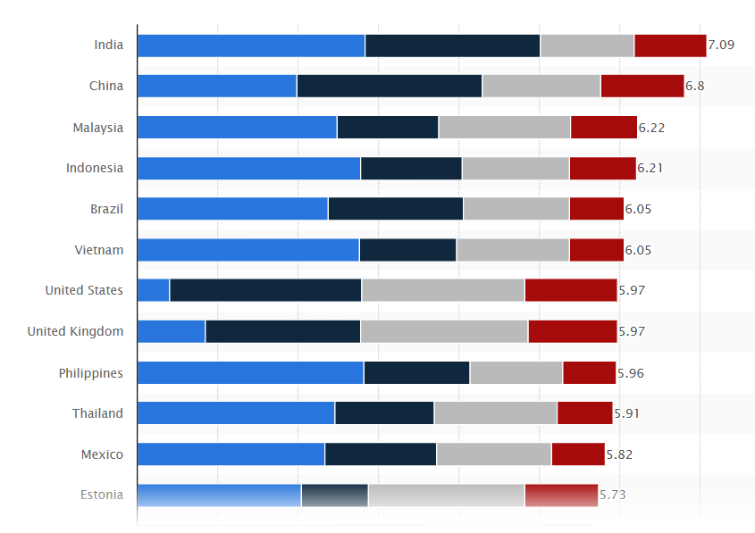

Leading countries in offshore business services worldwide in 2021

Slide 23

Active areas for Outsourcing
Ethics in Information Technology, Fourth Edition

Slide 24
Pros Offshore Outsourcing
Wages that a local worker might consider low represent an excellent salary in many other parts of the world, and some companies feel they would be foolish not to exploit such an opportunity.
Offshore demand is driving up salaries in India by roughly 15 percent per year.
Indian offshore suppliers have begun to charge more for their services
The cost advantage for offshore outsourcing to India used to be 6:1 worker. The cost advantage has now shrunk to 3:1.
This meant that hiring one worker in the U.S. or UK cost the same as hiring six workers in India. Now, hiring one worker in the U.S. costs the same as hiring only three workers in India.

Slide 25
Pros Offshore Outsourcing
a virtual “24-hour workday” that saves its customers money, speeds projects to completion, and provides continuous support for key software applications.
Getting expert help
If you outsource most of the tasks, you don’t have to worry about many employees separate desks, computers, life insurance, vacation, personal problems, sickness, 15 plus holidays, retirement etc.

Slide 26
Cons Offshore Outsourcing
Determining how much money and time a company will save with offshore outsourcing
The firm must take into account the additional time that will be required to select an offshore vendor as well as the additional costs that will be incurred for travel and communications.
It can take years of ongoing effort and a large up-front investment to develop a good working relationship with an offshore outsourcing firm.
Finding a reputable vendor can be especially difficult for a small or midsized firm that lacks experience in identifying and selecting contractors.
Members of a department can become bitter and nonproductive, and morale can become extremely low.

Slide 27
Cons Offshore Outsourcing
Cultural and language differences can cause misunderstandings among project members in different countries
Indian programmers, for instance, are known for keeping quiet even when they notice problems. And the difficulty of communicating directly with people over long distances can make offshore outsourcing perilous, especially when key team members speak English as their second language.

Slide 28
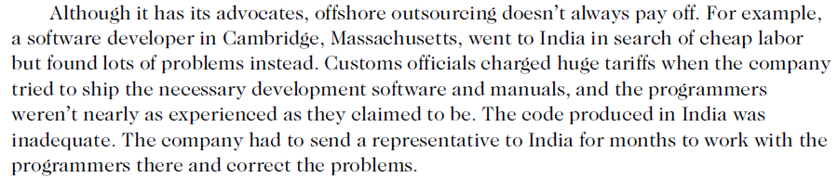
Cons Offshore Outsourcing

Slide 29
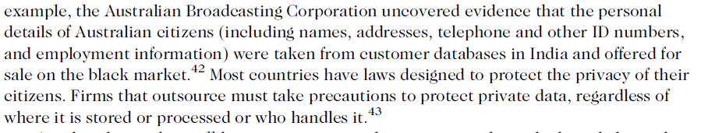
Cons Offshore Outsourcing

Slide 30
Cons Offshore Outsourcing
Company loses the knowledge and experience gained by outsourced workers
offshore outsourcing does not advance the development of permanent IT workers

Slide 31
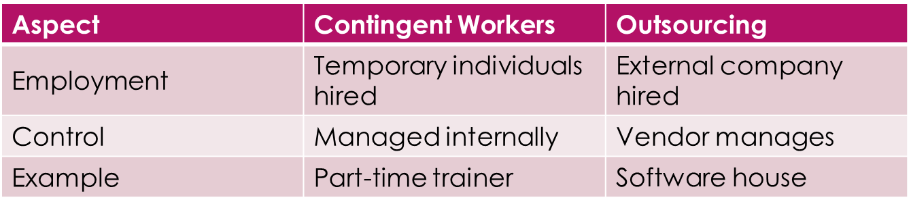
Comparison (Contingent workers and Outsourcing)

Slide 32
Activity – 'Who Will Do the Job?'
Each group receives job cards
Decide: Contingent Worker or Outsourcing
Place under the right category

Slide 33
Example Job Cards
Designing a company logo
Running a call center
Teaching a 4-week IT course
Catering an office event

Slide 34
Scenario
Your class is organizing a Farewell Party + Concert. You need food, music, decorations, photography, and games. But you can’t do everything yourself. Should you hire individuals (contingent workers) or outsource to a company?
Singer with one good song (Contingent worker candidate)
Catering company (Outsourcing option)
Event management company (Outsourcing option)
Bakery that delivers cake + decorations (Outsourcing option)

Slide 35
Key Takeaways
Contingent workers = temporary individuals hired directly
Outsourcing = hiring an external company
Both give flexibility but differ in control & cost

Slide 36
Whistle-Blowing

Slide 37
Whistle-Blowing
Effort to attract public attention to a negligent, illegal, unethical, abusive, or dangerous act by a company
Employees who act as informants on their company, revealing information to enrich themselves or to gain revenge for a perceived wrong.
whistle-blowers act ethically in an attempt to correct what they think is a major wrongdoing, often at great personal risk.

Slide 38
Whistle-Blowers
Whistle-blower
  Usually has personal or special knowledge
  Risks own career
  Might even affect lives of friends and family
  Must choose between protecting society and remaining silent
Notes:
A whistle-blower usually has personal knowledge of what is happening inside the offending
organization because of his or her role as an employee of the organization. Sometimes
the whistle-blower is not an employee but a person with special knowledge gained from a
position as an auditor or business partner.

Slide 39
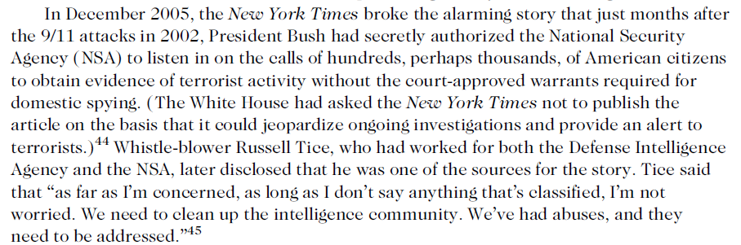
Whistle Blowing Example

Slide 40
Protection for Whistle-Blowing
Protection laws allow employees to alert authorities to employer actions that are unethical, illegal, or unsafe or that violate specific public policies
  No comprehensive federal law

Slide 41
Whistle-Blowing protection for private-sector workers
Whistle-blower Many states, not all, have laws that prevent workers from being fired because of an employee’s participation in “protected” activities
Whistle-blowers can file claims against their employers for retaliatory termination
Whistle-blowers are entitled to jury trials
If successful at trial, can receive damage awards

Slide 42
Dealing with a whistle-blowing situation
  Each potential whistle-blowing case involves different circumstances, issues, and personalities.
  Two people working together in the same company may have different values and concerns that cause them to react in different ways to a particular situation—and both reactions might be ethical.
  It is impossible to outline a definitive step-by-step procedure of how to behave in a whistle-blowing situation.

Slide 43
Dealing with a whistle-blowing situation
  Assess the seriousness of the situation
  Begin documentation
  Attempt to Address the Situation Internally
  Consider Escalating the Situation Within the Company
Notes:
On the other hand, the outside resources may reinforce the employee’s initial suspicions, forcing a series of difficult ethical decisions.

Slide 44
Assess the Implications of Becoming a Whistle-Blower
An employee may incur significant legal fees in order to air or bring charges against an agency or company that may have access to an array of legal resources.
An employee who chooses to proceed might be accused of having a grievance with the employer or of trying to profit from the accusations.
The employee may be fired and may lose the confidence of coworkers, friends, and even family members.

Slide 45
Assess the Implications of Becoming a Whistle-Blower
Whistle-blowers can expect attacks on their personal integrity and character as well as negative publicity in the media.
Friends and family members will hear these accusations, and ideally, they should be notified beforehand and consulted for advice before the whistle- blower goes public.
This notification helps prevent friends and family members from being surprised at future actions by the whistle-blower or the employer.
The whistle-blower should also consider consulting support groups, elected officials, and professional organizations.
  For example, the Whistleblowers Center provides referrals for legal counseling and education about the rights of whistle-blowers

Slide 46
Use Experienced Resources to Develop an Action Plan
A whistle-blower should consult with competent legal counsel who has experience in these kinds of cases.
He or she will determine which statutes and laws apply, depending on the agency, employer, state involved, and nature of the case.
Counsel should also know the whistle-blower’s protection under the law.
Before blowing the whistle, the employee should get an honest assessment of the soundness of his or her legal position and an estimate of the costs of a lawsuit.

Slide 47
Execute the Action Plan
If the whistle-blower wants to remain unknown, the safest course of action is to leak information anonymously to the press.
The problem with this approach, however, is that anonymous claims are often not taken seriously.
In most cases, working directly with appropriate regulatory agencies and legal authorities is more likely to get results, including the imposition of fines, the halting of operations, or other actions that draw the offending organization’s immediate attention.

Slide 48
Live with the Consequences
Discredited by coworkers
Threatened
management may attempt to have the whistleblower, transferred, demoted, or fired for breaking some minor rule, such as arriving late to work or leaving early.
To justify their actions, management may argue that such behavior has been ongoing.
The whistle-blower might need a good strategy and a good attorney to counteract such actions and take recourse under the law.

Slide 49
Summary
Contingent workforce includes:
  Independent contractors
  Temporary workers through employment agencies
  On-call or day laborers
  On-site workers provided by contract firms
Outsourcing
  Long-term business arrangement
  Contract for services with outside organization
  Expertise in providing a specific function
Ethics in Information Technology, Fourth Edition

Slide 50
Summary (cont’d.)
Whistle-blowing
  Effort to attract public attention to negligent, illegal, unethical, abusive, or dangerous acts by company
  Whistle-blowing process
    Assess the seriousness of the situation
    Begin documentation
    Attempt to address the situation internally
    Consider escalating the situation within the company
    Assess the implications of becoming a whistle-blower
    Use experienced resources to develop an action plan
    Execute the action plan
    Live with the consequences
Ethics in Information Technology, Fourth Edition

